Slide 1




Slide 2


Play through the world on
Join Now!
Welcome back!
Just keeping an eye

Slide 3



Glad to have you here!
I’m already a member!
Name:
UPLOAD PHOTO
1° Last Name:
2° Last Name:
Email:
Birthday:
dd/mm/yyyy
Country:
Username:
Password:
◉
Lead Team:
CONTINUE

Slide 4

Glad to have you here!
Name:
UPLOAD PHOTO
1° Last Name:
2° Last Name:
Email:
Birthday:
dd/mm/yyyy
Country:
Username:
Password:
◉
We’ve sent you a message!
Lead Team:
CONTINUE

Slide 5


username
Already going?:(
GLOBAL
CHATS
FULL GAMES
lead team
Total Events: | 20
Score: | 1500
Precision: | 75%
|
VOTED
GAME INFORMATION
✔
NOW PLAYING
🏁 VS 🏁
✔
CONCLUDED
🏁 VS 🏁
DRIPPKING POINTS
HISTORY
🏁 VS 🏁
…
ON TIME
🏁 VS 🏁
500
500
🏁 VS 🏁
…
ON TIME
🏁 VS 🏁
500
🏁 VS 🏁
✘
NOW PLAYING
🏁 VS 🏁
500
🏁 VS 🏁
…
ON TIME
🏁 VS 🏁
🏁 VS 🏁
✘
CONCLUDED
🏁 VS 🏁
500

Slide 6
Any changes?
Name:
UPLOAD PHOTO
1° Last Name:
2° Last Name:
Email:
Birthday:
dd/mm/yyyy
Country:
Username:
Password:
◉
Lead Team:
CONFIRM

Slide 7
Username 4
RETURN TO FRIENDS
lead team
Total Events: | 43
Score: | 10000
Precision: | 85%
|
VOTED
GAME INFORMATION
✔
NOW PLAYING
🏁 VS 🏁
✔
CONCLUDED
🏁 VS 🏁
DRIPPKING POINTS
HISTORY
HISTORY
🏁 VS 🏁
…
ON TIME
🏁 VS 🏁
🏁 VS 🏁
500
🏁 VS 🏁
🏁 VS 🏁
🏁 VS 🏁
…
ON TIME
500
🏁 VS 🏁
✘
NOW PLAYING
🏁 VS 🏁
🏁 VS 🏁
500
🏁 VS 🏁
…
ON TIME
🏁 VS 🏁
🏁 VS 🏁
500
🏁 VS 🏁
✘
CONCLUDED
🏁 VS 🏁
🏁 VS 🏁
500

Slide 8
We’ve been waiting for you!
Username:
Password:
◉
CONTINUE
Sign Up

Slide 9






CHATS
PROFILE
FULL GAMES
FRIENDS
Jazmen2002
4
Jazmen2002
LMEADOS
gaelkreisy
2
♕TILINES♕
15
CHECKLIST
LAAA TAAAAN
✔
Avanzar POI
LMEADOS
2
OV Modelos
Hola profe!!
Ni pa’ la muela chaparro
Una raya más al tigre
Llevo 2 horas acá holaaa
No los conozco

Slide 10
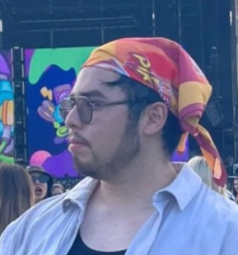
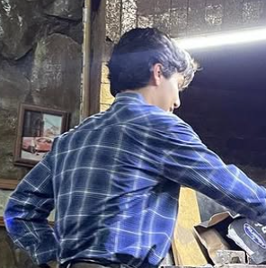
CHATS
PROFILE
FULL GAMES
FRIENDS
Jazmen2002
4
Jazmen2002
LMEADOS
gaelkreisy
2
LMEADOS
Created on: dd/mm/yyyy
Members:
ADMIN Jazmen2002
Gaelkreisy
username
♕TILINES♕
15
CHECKLIST
LAAA TAAAAN
✔
Avanzar POI
LMEADOS
2
OV Modelos
Hola profe!!
Ni pa’ la muela chaparro
Una raya más al tigre
Llevo 2 horas acá holaaa
No los conozco

Slide 11
CHATS
PROFILE
FULL GAMES
FRIENDS
Jazmen2002
4
Jazmen2002
LMEADOS
gaelkreisy
2
♕TILINES♕
15
CHECKLIST
LAAA TAAAAN
✔
Avanzar POI
LMEADOS
2
OV Modelos
Hola profe!!
Ni pa’ la muela chaparro
Una raya más al tigre
Llevo 2 horas acá holaaa
No los conozco

Slide 12


Jazmen2002
username

Slide 13
LMEADOS
Jazmen2002
username
gaelkreisy

Slide 14






FRIENDS
PROFILE
FULL GAMES
CHATS
Your Friends
SEARCH
Search
Jazmen2002
Results
gaelkreisy
Username 2
Username 3
Username 4
Friendship Requests
Username 5
VIEW PROFILE
ADD FRIEND

Slide 15
FRIENDS
PROFILE
FULL GAMES
CHATS
Your Friends
SEARCH
Search
Jazmen2002
Results
gaelkreisy
Username 2
Username 3
Username 4
Friendship Requests
Username 5
Friendship Request Sent!
VIEW PROFILE
ADD FRIEND

Slide 16
FRIENDS
PROFILE
FULL GAMES
CHATS
Your Friends
SEARCH
Search
Jazmen2002
Results
gaelkreisy
Username 2
Username 3
Username 4
Friendship Requests
Username 5
VIEW PROFILE
ADD FRIEND

Slide 17


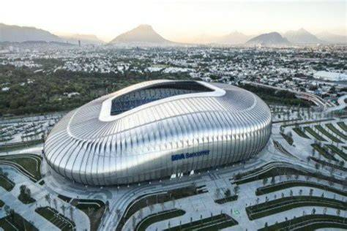
JOIN NOW!
LOG IN
LOCAL
VISITOR
GAME LIST
EVERY GAME EVERY TIME
NOW PLAYING
🏁 VS 🏁
VS
CONCLUDED
🏁 VS 🏁
ON TIME
🏁 VS 🏁
QUARTERFINALS
PLACE: | Estadio Banamex, MTY, N.L.
DATE: | 25/06/2026 14:00HRS
DRIPPKING POINTS: | 500
ON TIME
🏁 VS 🏁
NOW PLAYING
🏁 VS 🏁
ON TIME
🏁 VS 🏁
CONCLUDED
🏁 VS 🏁
VOTE NOW!

Slide 18
PROFILE
CHATS
GLOBAL
LOCAL
VISITOR
GAME LIST
EVERY GAME EVERY TIME
NOW PLAYING
🏁 VS 🏁
VS
CONCLUDED
🏁 VS 🏁
ON TIME
🏁 VS 🏁
QUARTERFINALS
PLACE: | Estadio Banamex, MTY, N.L.
DATE: | 25/06/2026 14:00HRS
DRIPPKING POINTS: | 500
ON TIME
🏁 VS 🏁
NOW PLAYING
🏁 VS 🏁
ON TIME
🏁 VS 🏁
CONCLUDED
🏁 VS 🏁
VOTE NOW!

Slide 19
PROFILE
CHATS
GLOBAL
LOCAL
VISITOR
GAME LIST
EVERY GAME EVERY TIME
NOW PLAYING
🏁 VS 🏁
VS
CONCLUDED
🏁 VS 🏁
ON TIME
🏁 VS 🏁
QUARTERFINALS
PLACE: | Estadio Banamex, MTY, N.L.
DATE: | 25/06/2026 14:00HRS
DRIPPKING POINTS: | 500
ON TIME
🏁 VS 🏁
NOW PLAYING
🏁 VS 🏁
ON TIME
🏁 VS 🏁
VOTE CONFIRMED! 🏃‍♂️‍➡️
CONCLUDED
🏁 VS 🏁
VOTE NOW!

Slide 20
PROFILE
CHATS
GLOBAL
LOCAL
VISITOR
GAME LIST
EVERY GAME EVERY TIME
NOW PLAYING
🏁 VS 🏁
VS
CONCLUDED
🏁 VS 🏁
ON TIME
🏁 VS 🏁
QUARTERFINALS
PLACE: | Estadio Banamex, MTY, N.L.
DATE: | 25/06/2026 14:00HRS
DRIPPKING POINTS: | 500
ON TIME
🏁 VS 🏁
NOW PLAYING
🏁 VS 🏁
ON TIME
🏁 VS 🏁
CONCLUDED
🏁 VS 🏁
VOTE NOW!

Slide 21
GLOBAL RANKING
PROFILE
FULL GAMES
DRIPPKINGERS
SCORE | TOTAL GAMES | PRECISION
Username 2
Username 3
Username 4
500000 | 60 | 95%
450000 | 65 | 94%
500000 | 75 | 90%
Username 6
Username 7
Username 8
25000 | 60 | 85%
500000 | 60 | 70%
500000 | 60 | 74%

